Slide 1
Title: Predicting the Outcome of Global Terrorist Activity
Name: Fahim Ahmed Shakil
Id: 1610736042
Section: 02

Slide 2
We have been working on a binary classification problem to determine the outcome of terrorist attack. In the mid presentation, I have already talked about data preprocessing and the fully connected neural network that I have build for which I have got an accuracy of 88%.

Slide 3
To improve the accuracy of the fully connected neural network, I have trained network with different architecture.

Slide 4
Increasing the Depth of the Network
Code:
model.add(Dense(120, input_dim=feature_size, activation='relu'))
model.add(Dense(80, input_dim=feature_size, activation='relu'))
model.add(Dense(60, input_dim=feature_size, activation='relu'))
model.add(Dense(50, input_dim=feature_size, activation='relu'))
model.add(Dense(30, input_dim=feature_size, activation='relu'))
Training the network with 5 hidden layers which gives an accuracy of 91%

Slide 5
Increasing the Depth of the Network
Code:
model.add(Dense(120, input_dim=feature_size, activation='relu'))
model.add(Dense(80, input_dim=feature_size, activation='relu'))
model.add(Dense(60, input_dim=feature_size, activation='relu'))
model.add(Dense(50, input_dim=feature_size, activation='relu'))
model.add(Dense(30, input_dim=feature_size, activation='relu'))
model.add(Dense(20, input_dim=feature_size, activation='relu'))
model.add(Dense(15, input_dim=feature_size, activation='relu'))
Training the network with 7 hidden layers which gives an accuracy of 90.81%

Slide 6
Increasing the Depth of the Network
Code:
model.add(Dense(120, input_dim=feature_size, activation='relu'))
model.add(Dense(80, input_dim=feature_size, activation='relu'))
model.add(Dense(60, input_dim=feature_size, activation='relu'))
model.add(Dense(50, input_dim=feature_size, activation='relu'))
model.add(Dense(30, input_dim=feature_size, activation='relu'))
model.add(Dense(20, input_dim=feature_size, activation='relu'))
model.add(Dense(15, input_dim=feature_size, activation='relu'))
model.add(Dense(10, input_dim=feature_size, activation='relu'))
model.add(Dense(5, input_dim=feature_size, activation='relu'))
model.add(Dense(3, input_dim=feature_size, activation='relu'))
Training the network with 10 hidden layers which gives an accuracy of 90.12%

Slide 7
Increasing the Width of the Network
Code:
model.add(Dense(500, input_dim=feature_size, activation='relu'))
model.add(Dense(50, input_dim=feature_size, activation='relu'))
Training the network with 2 hidden layers with 500 nodes in first layer and 50 nodes in the 2nd hidden layer gives an accuracy of 91.13% which is the best accuracy achieved by changing the architecture of the network.

Slide 8
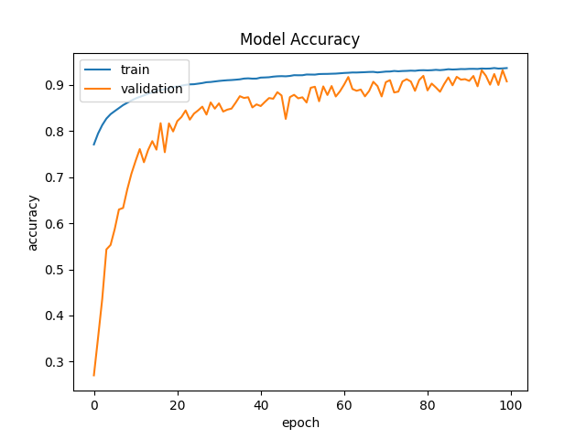
Training the network with 2 hidden layers of 500 and 50 nodes I got this train and validation accuracy over 100 epoch and test accuracy of 91.13%.

Slide 9
Adding Dropout Layer
Code:
model = Sequential()
model.add(Dropout(0.2, input_shape=(feature_size,)))
model.add(Dense(500, activation='relu', kernel_constraint=maxnorm(3)))
model.add(Dense(50, activation='relu', kernel_constraint=maxnorm(3)))
model.add(Dense(1, activation='sigmoid'))
To improve accuracy further, I have added dropout layer to input layer first with dropout rate 20% and kernel constraint of maxnorm=3 to ensure the maximum norm of weights does not exceed value 3. After training the model I got an accuracy of 90.8% which is less than already achieved maximum accuracy.

Slide 10
Adding Dropout Layer
Code:
model = Sequential()
model.add(Dropout(0.2, input_shape=(feature_size,)))
model.add(Dense(500, activation='relu', kernel_constraint=maxnorm(3)))
model.add(Dense(50, activation='relu', kernel_constraint=maxnorm(3)))
model.add(Dense(1, activation='sigmoid'))
Next I added dropout layer to hidden layers instead of input layer with with dropout rate 20% and kernel constraint of maxnorm=3 and trained the model. This results in an increase in test accuracy which is 92%

Slide 11
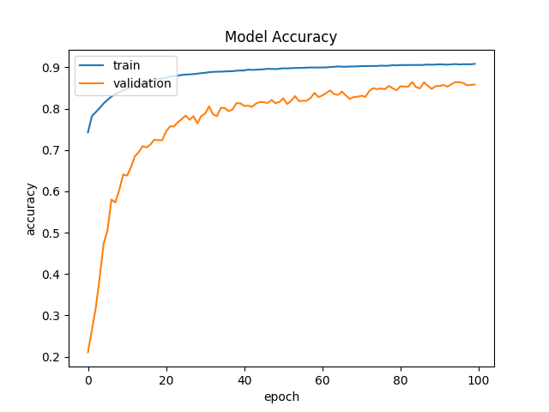
Training the network with dropout layer added between hidden layers gives test accuracy of 92%.

Slide 12
Batch Normalization
Code:
model = Sequential()
model.add(Dense(500, input_dim=feature_size, activation='relu', kernel_constraint=maxnorm(3)))
model.add(Dropout(0.2))
model.add(BatchNormalization())
model.add(Dense(50, activation='relu', kernel_constraint=maxnorm(3)))
model.add(Dropout(0.2))
model.add(BatchNormalization())
Adding batch normalization between hidden layers with the accuracy increased by .2% which is 92.2%

Slide 13
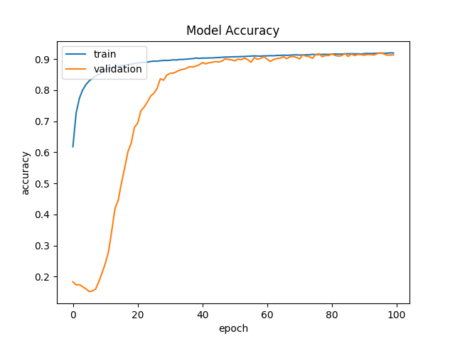
After adding batch normalization between hidden layers the validation accuracy gets almost similar to train accuracy as epoch closes to 100.

Slide 14
Applying Different Optimizers
Code:
model.compile(loss='binary_crossentropy', optimizer='adam', metrics=['accuracy'])
model.compile(loss='binary_crossentropy', optimizer=sgd, metrics=['accuracy'])
I have trained the network with different optimizers - adam and stochastic gradient descent (sgd).

Slide 15
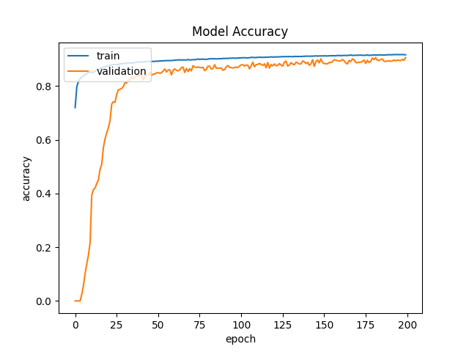
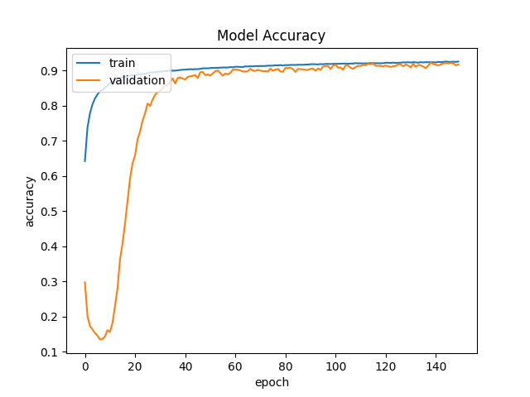
Using both the optimizers I achieved similar accuray - 92.05 % for sgd and 92.2% for adam.

Slide 16
Conclusion
The highest test accuracy I have achieved for this binary classification problem using a fully connected neural network is 92.2%.

